Slide 1
CHURN PREDICTION
BY
SUDARSAN R
VIJAY SINGH

Slide 2
AGENDA
Introduction
Data Sets
Methodology
Results
Conclusion

Slide 3
Introduction
The subscribers to a service that discontinue their subscription to that service in a given time period is mentioned as Churn.
Telephone service companies, Banks, Internet Service providers, Pay TV companies, Insurance Firms, etc., often uses Customer Attrition Analysis and Customer Attrition rate as one of their key Business Metrics because the cost of “retaining the existing customer is far less than accruing a new one”.
Churn types, - Voluntary Churn - Involuntary Churn

Slide 4
The problem of churn originated from European countries where the matured markets gave an incentive to the operators to try to attract customers from competitors. From a global perspective, churn of mobile operators led them to loss of ~$100 billon USD per year (Berson et al., 2000).
It has assumed alarming proportions in growth markets like India as well.
According to Gartner research, India’s churn rate is a high 3.5 – 6% a month, aggregating to ~40- 50% every year.
This fact combined with the high installation and marketing costs, makes it 5-10 times more expensive to acquire a new customer than to retain an existing one (Ruta et al., 2006).

Slide 5
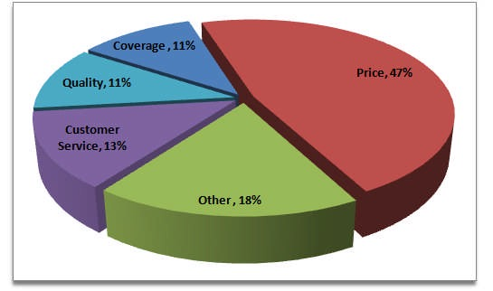

Slide 6
PROBLEM STATEMENT
In the competitive business environment a lot of effort is spent on attracting and maintaining customers
The cost to maintain an existing customer is much less than acquiring new one. This makes it paramount for organizations to understand what factors contribute to the turnover of clients and enact preventative strategies to reduce turnover.
This turnover is often refereed to as the Churn or Churn rate.

Slide 7
OBJECTIVE
Finding Churned customers behavioral pattern from dataset
Based on assumptions or hypothesis build a churn prediction model

Slide 8
DATASET
The Dataset we are working with contains a variety of information related to customers like,
Payment details
Minutes of voice usage Incoming/Outgoing
Data usage
Activation and disconnection details

Slide 9
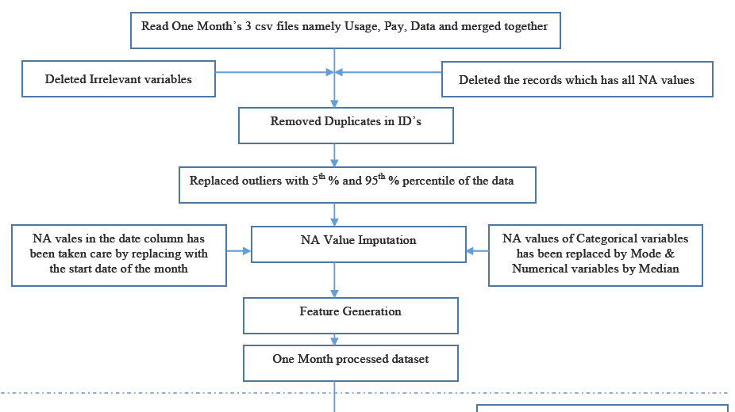
METHODOLOGY

Slide 10
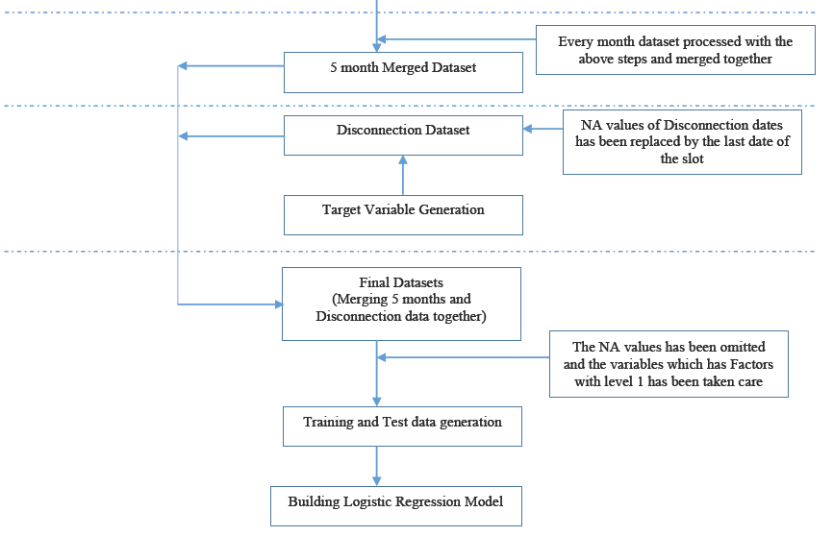
Methodological Flow Chart

Slide 11
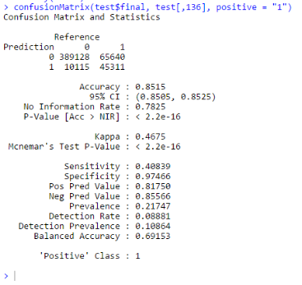
Results

Slide 12
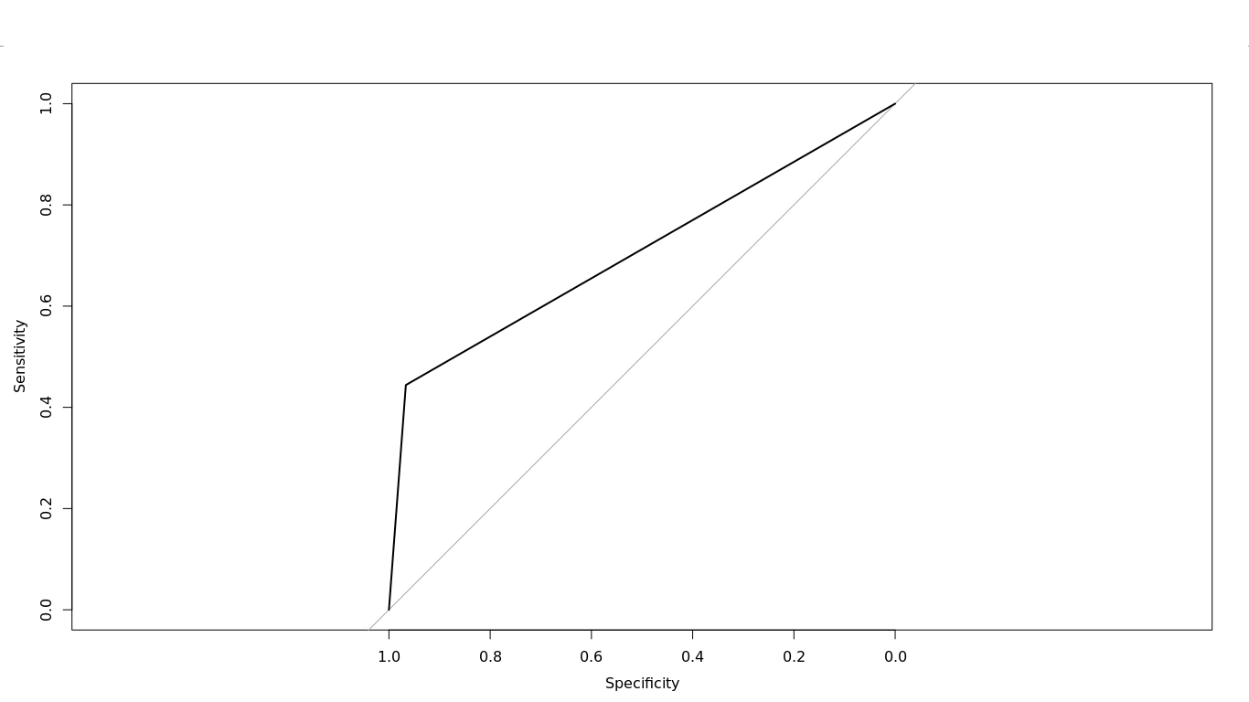

Slide 13
CONCLUSIONS AND FUTURE WORK
This project has focused to identify the factors that influence customer churn in telecommunication.
The analysis focused on churn prediction based on logistic regression and R programming.
Additional variables required to increase our model’s predictive power:

Slide 14
Migration data
Number of days between inactivity and recharge
Remaining balance
Location data
Watching churn events more closely

Slide 15

THANK YOU

